Slide 1
Final Project Report

Slide 2
What have we done?
Persuasion Strategies Dataset
Dialogue Acts Dataset
Machine Learning Based Model for Classifying Persuasion Strategies

Slide 3
How did we do it?
Identified appropriate dataset
Trained and supervised annotators
Distilled tagset
Calculated Agreement
Trained annotators again
Marked up the Data
Processed and exported the data
Trained a model on the data
Evaluated the data
Wrote it all up
I will email you my report

Slide 4
Identifying a dataset
Change my view
Users trying to change other users’ mind online
Labeled with Delta symbol if the original poster’s mind was successfully changed
Very long text and not conversational
Persuasion for good
Online conversations between users trying to convince each other to donate to charity
Annotated with persuasion strategies
Perverted Justice
Chatroom transcripts between vulnerable users and suspected malicious agents

Slide 5
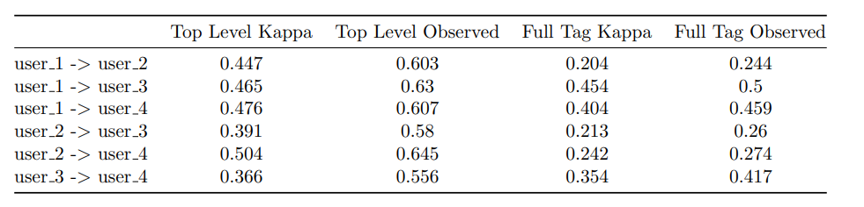
Initial Data Mark-up
5 transcripts
Annotated between the project group
Analysed for agreement
Agreement amongst top level tags
Lower agreement on full tags
Kappa score takes into account chance agreement

Slide 6
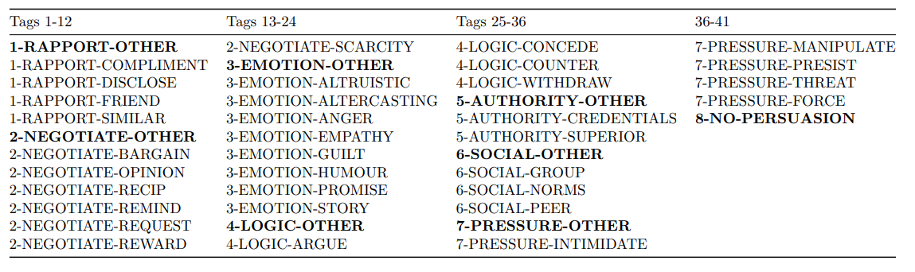
Conclusions from initial markup
Changes to the framework
Lowest level tags are left out
‘Other’ tag added as a bottom level tag
Annotators will need some training
Would also be good to keep in contact and have multiple meetings
An intermediate task for the annotators to monitor agreement

Slide 7
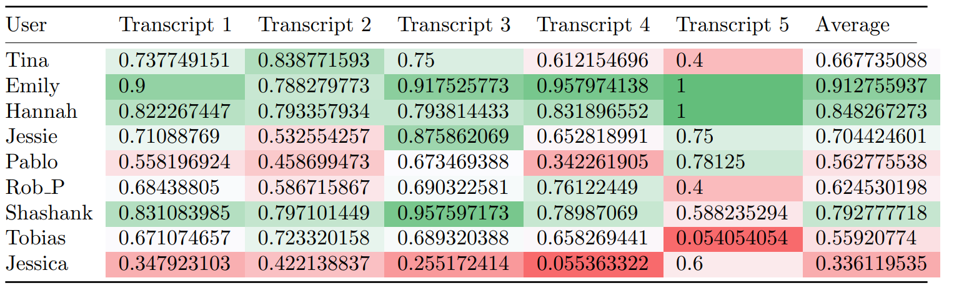
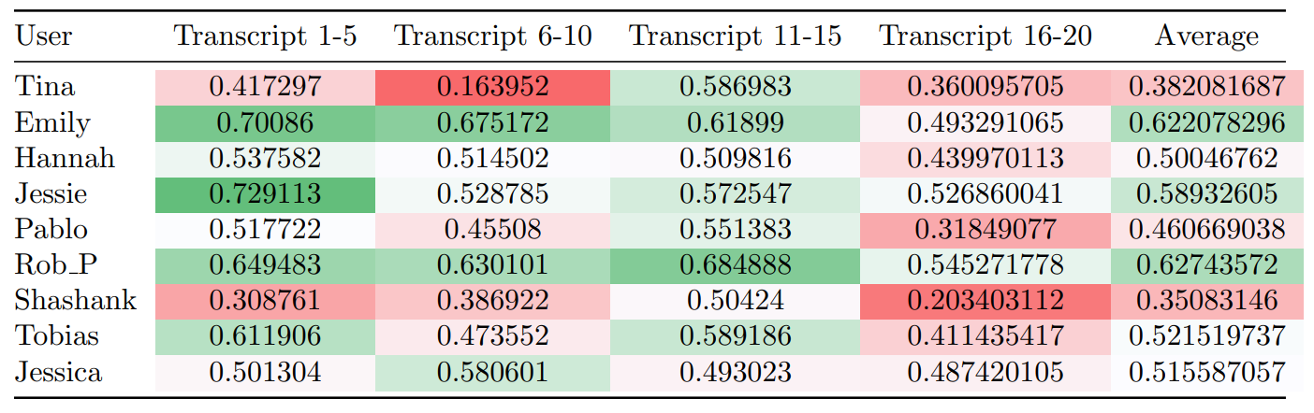
Data markup with external annotators
5 Transcripts agreement
Conclusions
Agreement measured over majority tag
Annotators required training and clarification over tags as some overlapped
Some annotators agreed more with the majority than others and some transcripts were more difficult to agree upon
Annotators could use more than one tag
20 Transcripts agreement

Slide 8
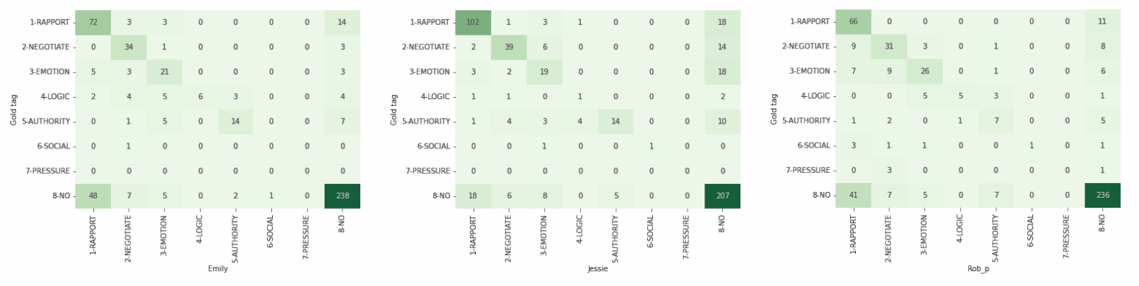
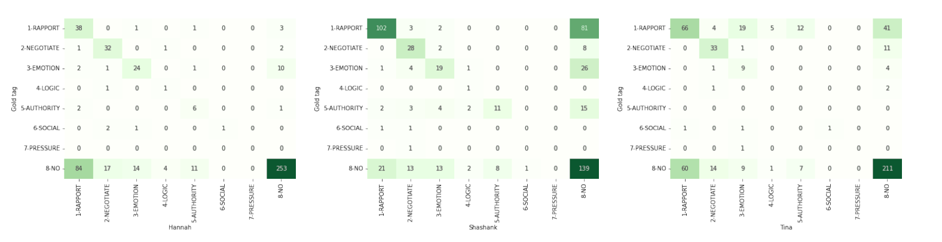
Tag Confusion Matrices
Most in agreement
Rapport was tagged the mode and disagreed the most
No persuasion also disagreed with rapport
Not a lot of representation of tags 6-7
Least in agreement

Slide 9
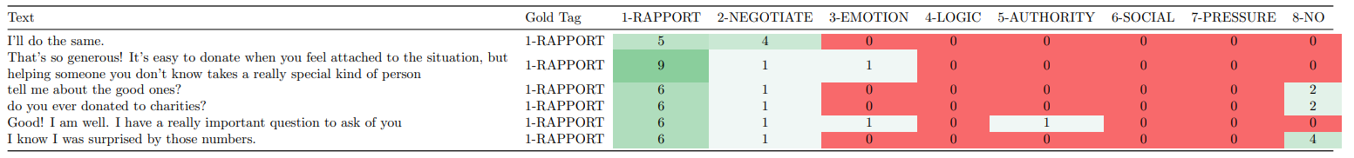
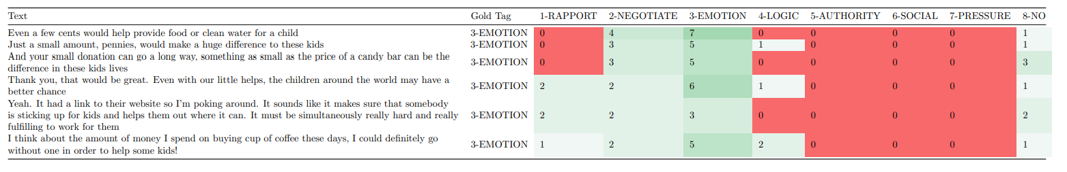
Annotator Training Conclusion
Rapport/Emotion tables
We had discussion on why they chose certain tags
Discussed the over use of Rapport and advised to consider more if it was being used conversationally or as a persuasion tactic
Was helpful to have dialogue with annotators
The agreement is not totally ideal
More training might be necessary are other methods to avoid using so many annotators such as active learing

Slide 10
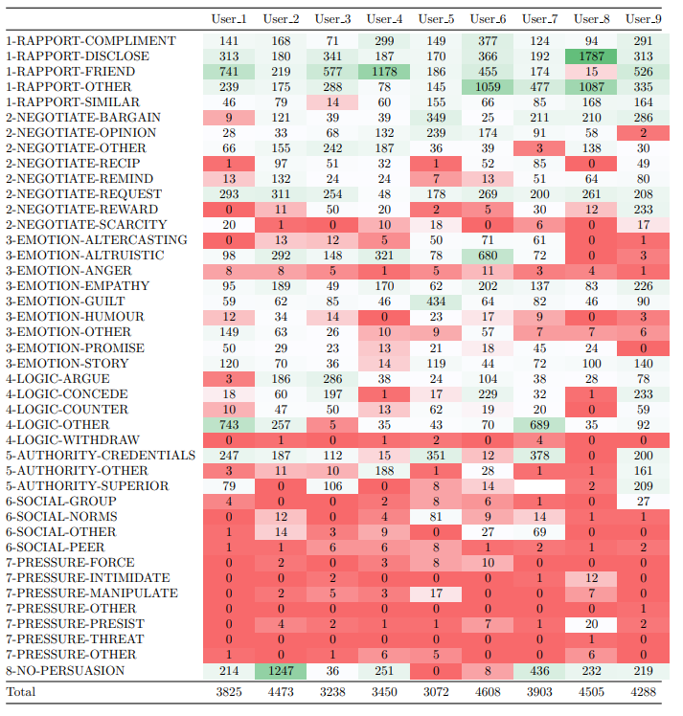
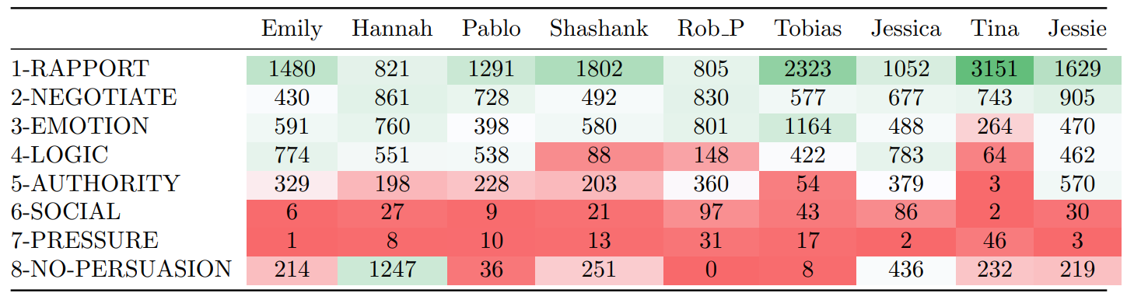
Main Markup
Took roughly two months
Most finished within a month
Distribution of tags followed roughly the same pattern as the training
Dataset clearly very friendly and conversational, no malicious persuasion
Top level tag distribution below

Slide 11
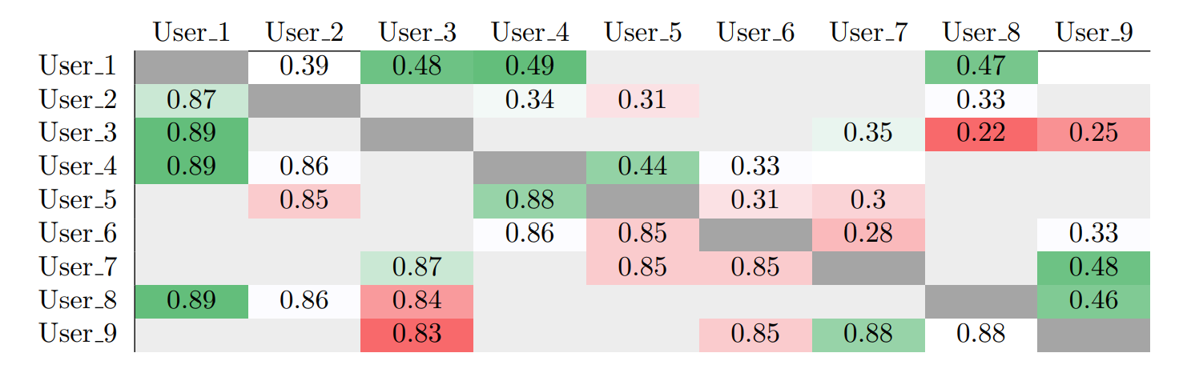
Inter-annotator Agreement
Kappa score: 0.36
Observed: 0.86
Relatively low agreement
No users attained 0.6
No Gold standard
Kappa score: 0.36
Observed: 0.86
Relatively low agreement
No users attained 0.6
No Gold standard

Slide 12
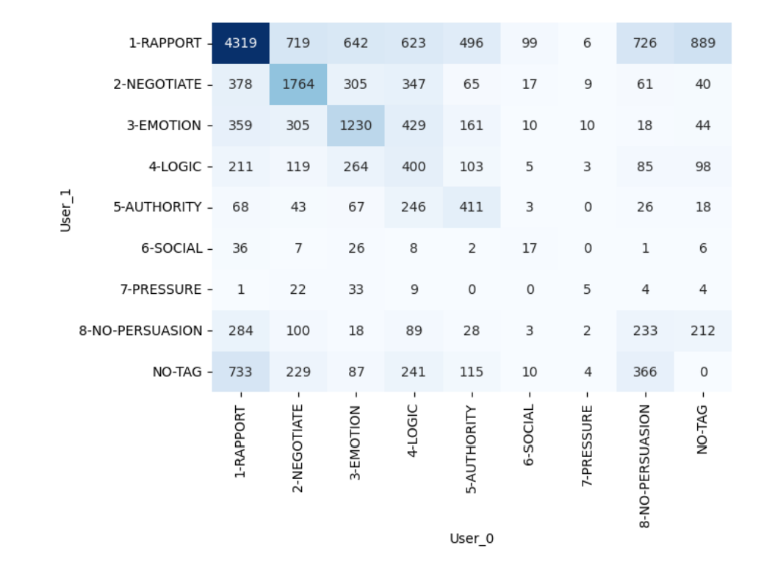
Phase 1 Conclusion
Data was successfully marked up
Agreement could have been a bit higher as this could indicate the quality of the annotations
1016 transcripts were collected
Took slightly longer than expected
Might like more training time with the annotators
The transcripts were rather similar
No malicious persuasion

Slide 13
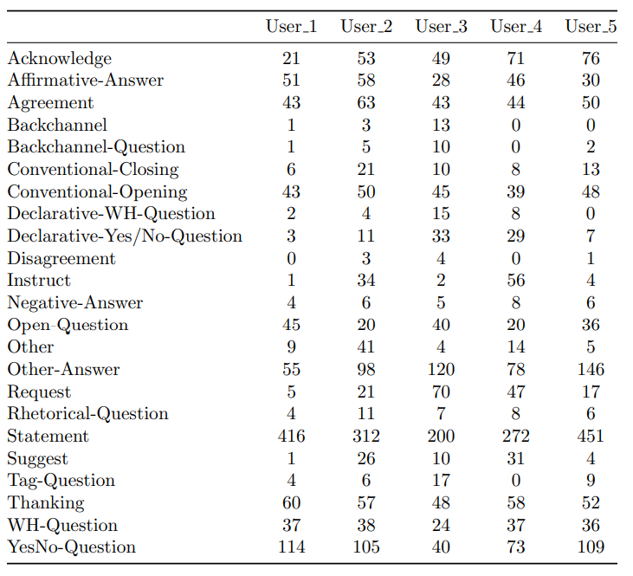
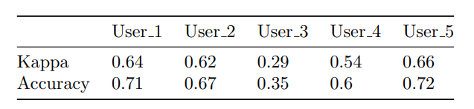
Dialogue Acts Corpus
Completed after the persuasion strategies dataset
Five annotators
Much higher agreement
Slightly easier task
Fewer tags
More logical and less abstract
Inter-annotator agreement measured against majority tag

Slide 14
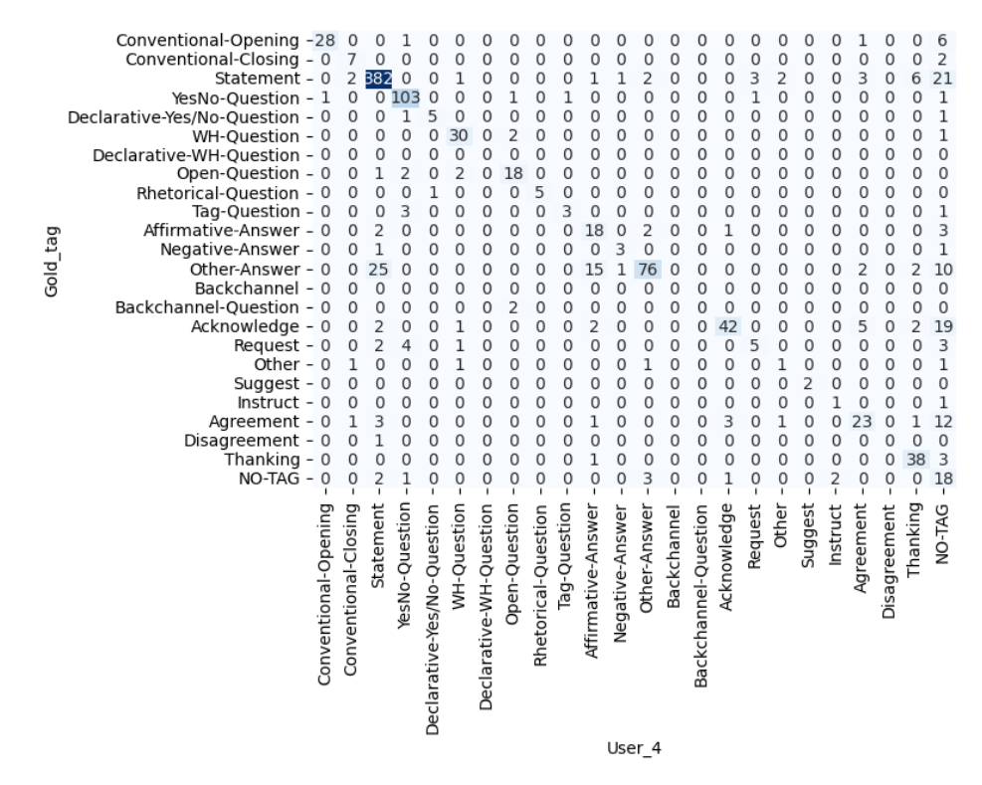
Dialogue Acts Confusion Matrix

Slide 15
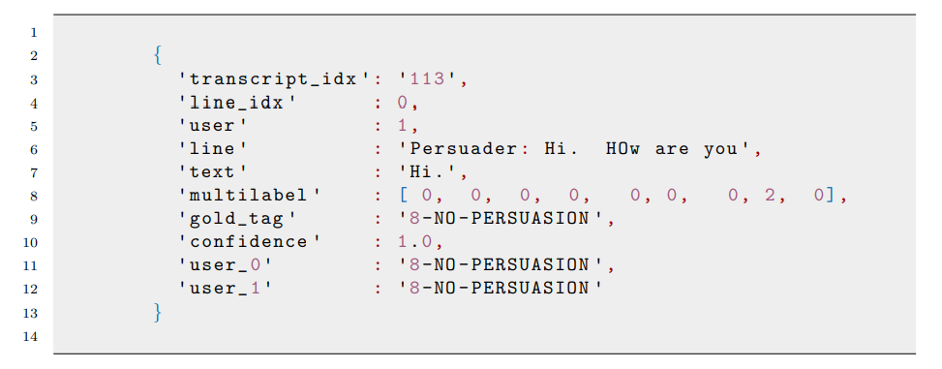
Phase 2: Exporting the data
JSON Format
Easily imported/exported
Jsonlist
Tag Format
Multilabel vector
Text labels
Both user’s annotations
Final export a list of JSONs
CSV format as well
Training and testing slightly different due to number of annotators
No majority tag in training
Training Example

Slide 16
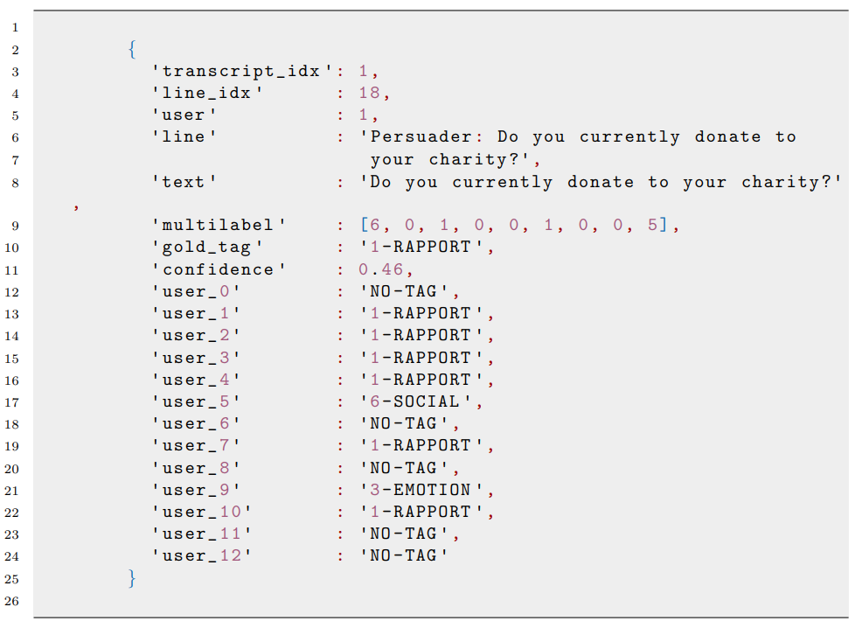
Testing Data
More annotators available
Top level tags only
Confidence score
Percentage of users that chose the majority tag
Held back just for testing the model

Slide 17
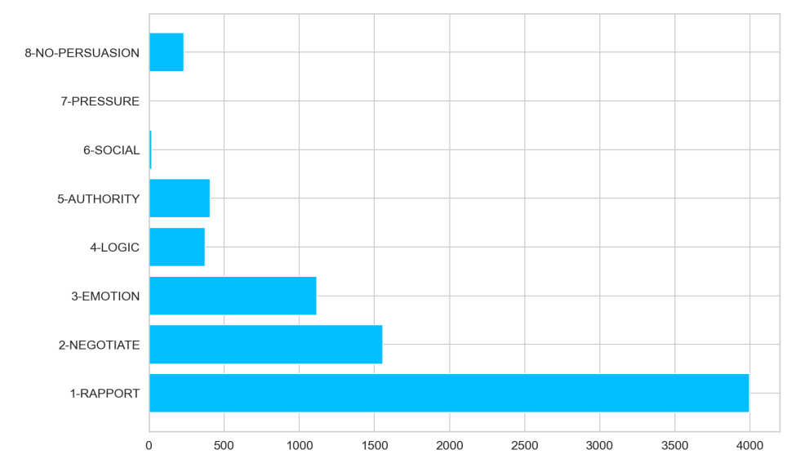
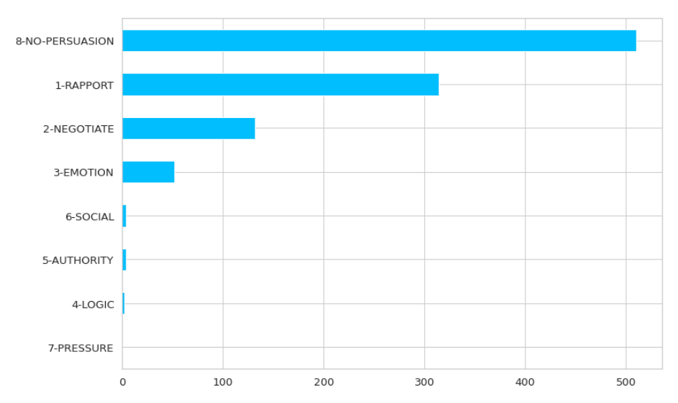
Tag Distribution in training

Slide 18
Modeling the Data
Language Representation
Bag of Words
Vector of word counts
Tfidf representation
Word embeddings
BERT encodes entire utterances rather than word by word
Deep learning
Models
Support Vector Machine
Requires less data
Fits hyperplane between class labels
Single labels only
Multilayer Perceptron
Perhaps needs more data
Learns the weights of the vocabulary
Outputs probability distribution over the tags
Multilabel outputs
BERT
Doesn’t require much data
Pretrained language model
Takes multilabel Outputs

Slide 19
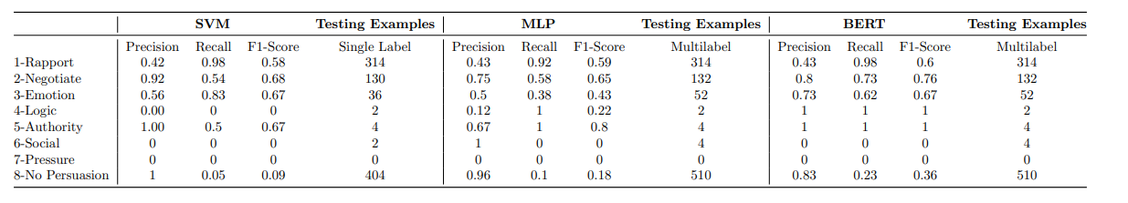
Results
SVM
Single label outputs
Very low performances with no persuasion
Not too bad at tags 2/3
MLP
Multilabel outputs
Slightly worse than SVM
Potentially slightly more general
Maybe needs more data
BERT
Multilabel outputs
Best results overall
Most generalised

Slide 20

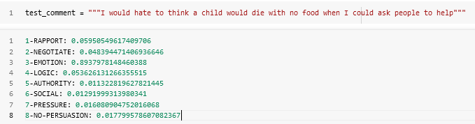
Conclusion
Building a dataset takes time
Inter-annotator agreement could have been higher
More training for annotators
Data domain perhaps too narrow
No Malicious persuasion
More data would help the model
Address data imbalance
Didn’t manage to get working any under/oversampling
The model could predict persuasion strategies
To an extent
Great foundation for further work
More data - especially malicious
Model tweaking - perhaps use persuadee utterances
Add dialogue act features to model

